Slide 1

A
Project Review Meeting on
Project Title
By
A.SINDHUJA 2420030094
B.SATHWIK 2420030048
K.VISHNU VARDHAN REDDY 2420030110
Team Number: 21
Under the guidance of
Dr. P. Srilatha
Associate Professor
Department of Computer Science and Engineering
Koneru Lakshmaiah Education Foundation
(Deemed to be University estd. u/s. 3 of the UGC Act, 1956)
Off-Campus: Bachupally-Gandimaisamma Road, Bowrampet, Hyderabad, Telangana - 500 043.
Phone No: 7815926816, www.klh.edu.in

Slide 2
Outline of the Presentation
Abstract
Introduction
Problem Statement
Project Flow Diagram
Objectives with Justification
Modules[Frontend web pages]
Expected Outcomes of the Proposed Work
Conclusion
References

Slide 3
Abstract
A customer feedback system for restaurants is a structured digital solution designed to collect, analyze, and act upon diners’ opinions to enhance service quality and customer satisfaction. The system provides multiple feedback channels such as QR codes, kiosks, mobile applications, or follow-up surveys to capture ratings and comments on food, service, ambience, and overall experience. By integrating simple rating tools with open-ended responses, the system ensures both quantitative and qualitative insights. Real-time monitoring and analytics dashboards help restaurant managers identify trends, address negative feedback promptly, and track improvements over time. Integration with POS and CRM systems further enables personalized customer engagement and loyalty-building. This approach not only improves operational efficiency but also fosters stronger customer relationships, positioning the restaurant for sustainable growth.

Slide 4
Introduction
Customer satisfaction is a critical factor in the success and sustainability of restaurants in today’s competitive food industry. With increasing customer expectations and the growing influence of online reviews, restaurants need efficient systems to capture and analyze feedback. Traditional methods such as comment cards or verbal suggestions are often limited, as they do not provide structured data for decision-making. A customer feedback system offers a digital and systematic approach to gathering opinions directly from diners through channels such as QR codes, kiosks, mobile applications, and follow-up surveys.
Such a system enables customers to share their experiences regarding food quality, service efficiency, ambience, and overall value, while allowing restaurant managers to access real-time insights. By incorporating features like rating scales, open-text feedback, and automated analytics dashboards, managers can detect patterns, respond quickly to negative reviews, and implement improvements. Moreover, integrating the feedback system with existing restaurant management tools, such as POS and CRM software, supports loyalty programs and targeted marketing.
Ultimately, a well-designed customer feedback system not only improves the dining experience but also strengthens the relationship between the restaurant and its patrons, thereby driving repeat business and long-term growth.

Slide 5
Problem Statement
lack of systematic feedback collection: Many restaurants collect feedback verbally, but they do not have a structured way to record, analyze, and utilize customer opinions.
Low response rate to feedback forms: Customers often ignore feedback forms due to length, lack of incentives, or inconvenient timing.
Difficulty in analyzing feedback: Restaurants receive both structured (ratings) and unstructured (comments) feedback, making it hard to extract meaningful insights.
Delayed action on complaints: Feedback about poor service, food quality, or hygiene is not addressed quickly, leading to customer dissatisfaction.
No personalized customer engagement: Restaurants fail to use feedback data to offer personalized discounts, menu suggestions, or loyalty programs.
Negative online reviews: Many customers prefer posting reviews on public platforms (Google, Zomato, Yelp) instead of giving feedback directly, which harms reputation.

Slide 6
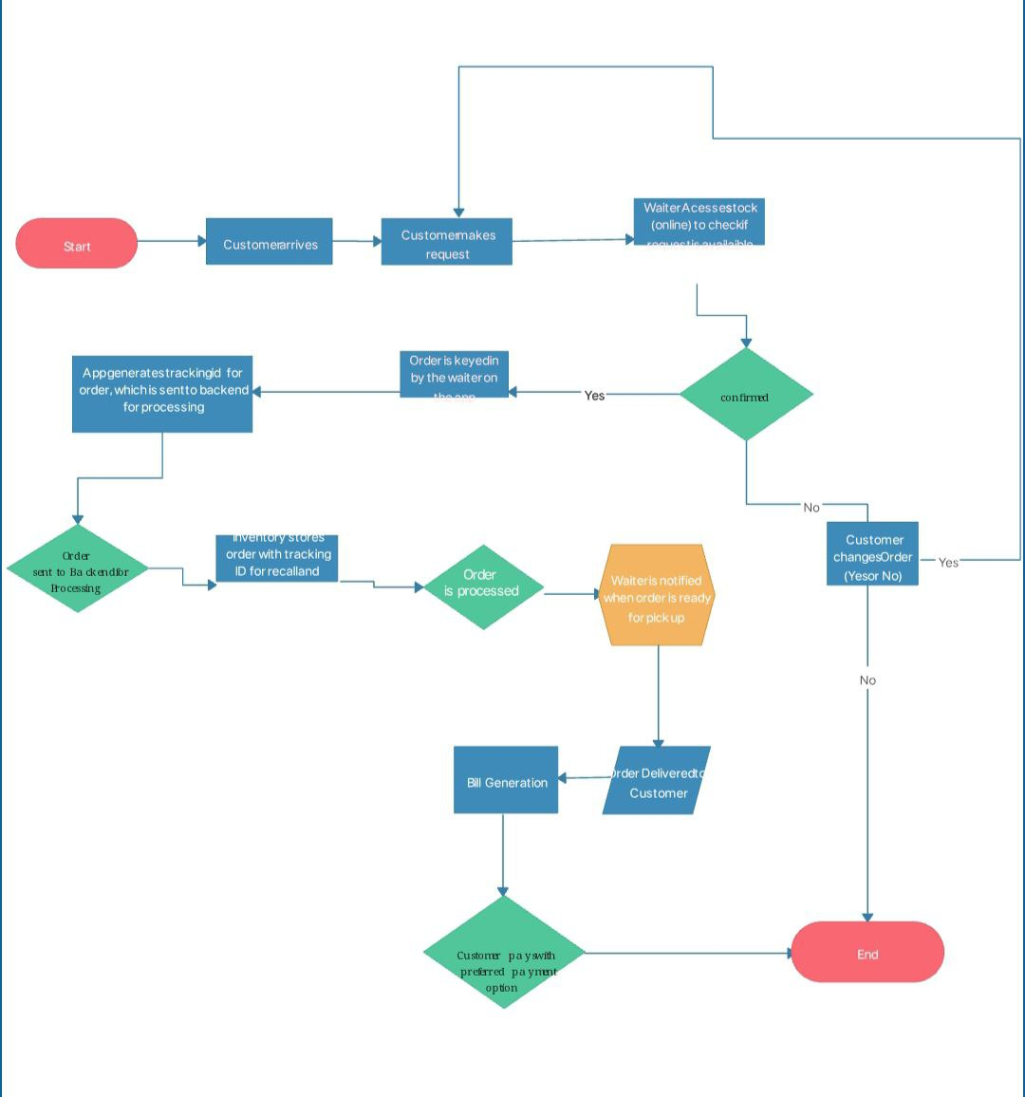
Project Flow Diagram

Slide 7
Objectives with Justification
OBJECTIVE | JUSTIFICATION
1. To develop a digital platform for collecting customer feedback | Traditional paper forms are inconvenient; a digital system increases participation and accuracy.
2. To enable real-time feedback submission and alerts | Allows managers to respond instantly to negative feedback and resolve issues on the spot.
3. To provide a user-friendly and mobile-responsive interface | Ensures that customers can easily access and complete the form on any device.
4. To generate analytical reports and dashboards | Helps management track trends, staff performance, and service quality over time.
5. To support customizable questions and feedback types | Restaurants can tailor the form to specific menus, events, or services.
6. To centralize feedback across multiple branches (if applicable) | Multi-location restaurants can manage and compare performance in a single platform.
7. To store feedback securely and ensure data privacy | Protects customer information and ensures compliance with data protection laws.

Slide 8
Modules [Frontend web pages]
1. Home Page
Purpose: Landing page with general info about the restaurant and access to feedback form.
Features:
  Restaurant branding
  Welcome message
  Navigation bar (Home, Menu, Feedback, Contact)
  “Leave Feedback” call-to-action button
🔹 2. Menu Page
Purpose: Display restaurant menu (optional for feedback system but useful).
Features:
  Categories (Starters, Main Course, Desserts, Drinks)
  Dish names, prices, and images
  Ratings or likes (optional)
🔹 3. Feedback Form Page
Purpose: Collect feedback from customers.
Features:
  Customer Name (optional or required)
  Visit date/time
  Rating system (1–5 stars or smiley faces)
  Dropdowns (food quality, service, ambiance, cleanliness)
  Textbox for additional comments

Slide 9
🔹 4. Feedback Confirmation Page
Purpose: Thank customers after feedback submission.
Features:
  Thank you message
  Summary of submitted feedback (optional)
  Link to return to Home or Menu
🔹 5. Admin Login Page
Purpose: Secure access for restaurant admin/staff.
Features:
  Username/password fields
  Login button
  Forgot password? (optional)
  Basic validation
🔹 6. Admin Dashboard Page
Purpose: View and manage customer feedback.
Features:
  Table of feedback entries (name, date, ratings, comments)
  Filters (by date, rating, category)
  Export to CSV/PDF
  Charts (bar, pie charts showing rating distribution)

Slide 10
🔹 7. Reports & Analytics Page
Purpose: Visual feedback summary.
Features:
  Overall satisfaction score
  Average ratings per category
  Trends over time
  Downloadable reports
🔹 8. Manage Users Page (Optional)
Purpose: Admins manage other users (staff).
Features:
  Add/edit/delete user accounts
  Assign roles (admin, viewer)
🔹 9. Contact Page
Purpose: Let customers contact the restaurant.
Features:
  Address, phone, email
  Google map integration
  Contact form

Slide 11
Conclusion and Future Scope
CONCLUSION
The development of a Customer Feedback System for Restaurants offers a structured and efficient way to collect, manage, and analyze customer opinions. This system enhances the restaurant’s ability to understand customer expectations, identify areas for improvement, and implement necessary changes to elevate service quality. With an intuitive user interface and real-time analytics, the platform empowers management to make data-driven decisions that directly contribute to customer satisfaction and loyalty. Overall, the system bridges the communication gap between diners and restaurant staff, creating a culture of continuous improvement and excellence.

Slide 12
FUTURE SCOPE
Mobile App Integration
  Develop dedicated Android and iOS apps for more convenient access to the feedback system.
AI-Powered Sentiment Analysis
  Implement Natural Language Processing (NLP) to automatically detect customer sentiment from written feedback.
Real-Time Alerts & Notifications
  Notify staff instantly about negative feedback for quicker resolution.
Multilingual Support
  Add support for regional and international languages to cater to a broader customer base.
Gamification & Rewards
  Encourage customers to leave feedback by integrating reward points or discount coupons.
Voice Feedback Support
  Allow customers to submit feedback using voice input, improving accessibility.
Integration with POS and CRM Systems
  Sync feedback data with Point-of-Sale and Customer Relationship Management tools for a seamless business workflow.
Advanced Analytics Dashboard
  Provide deeper insights through predictive analytics and trend forecasting.

Slide 13
References
TITLE A Qualitative Analysis of the Customers’ Perceptions of the Restaurant Services in Bengaluru. AUTHOR K. Sreenivasa Murthy & K. Sai Kumar (2023) WHAT IT COVERS Explores customers’ expectations vs perceptions in restaurants, using SERVQUAL dimensions (tangibility, reliability, responsiveness, assurance, empathy). Finds gaps in service, especially during peak hours and in offering safety and environment

Slide 14
Thank you

